Slide 1



FlavorWiki Power BI
Last data refresh:
12/16/2022 6:22:35 PM UTC
Downloaded at:
2/11/2023 5:10:49 PM UTC

Slide 2
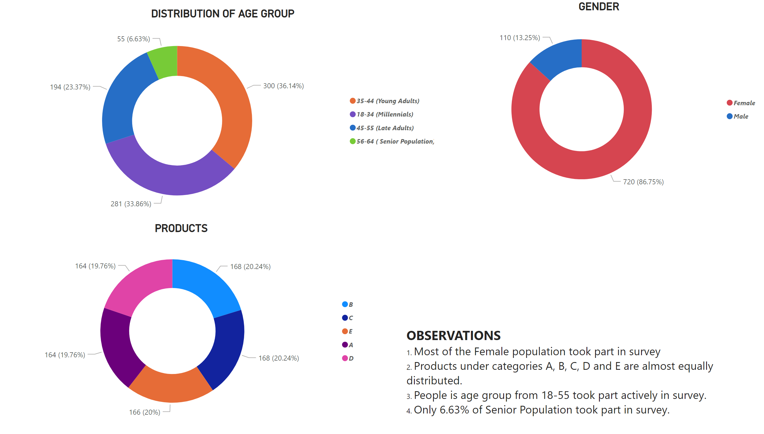
PRODUCTS AND POPULATION
Notes:
DISTRIBUTION OF AGE GROUP
No alt text provided
PRODUCTS
No alt text provided
GENDER
No alt text provided
textbox
No alt text provided

Slide 3
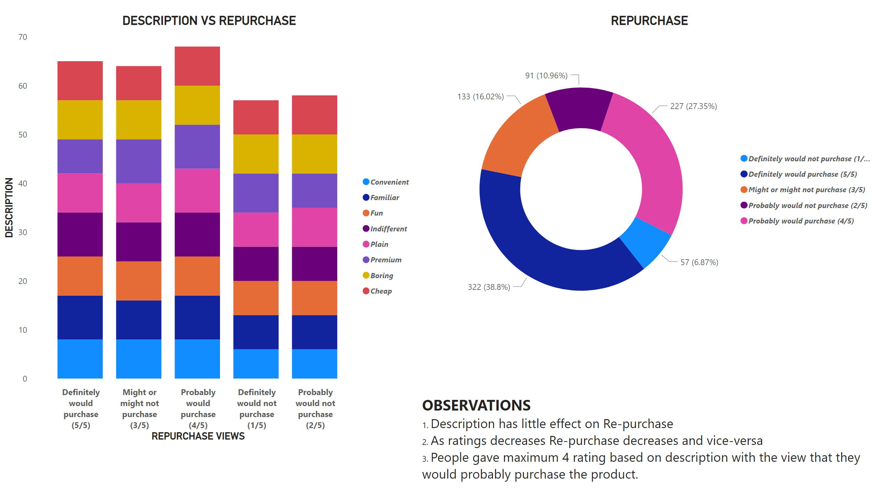
DESCRIPTION-REPURCHASE
Notes:
DESCRIPTION VS REPURCHASE
No alt text provided
REPURCHASE
No alt text provided
textbox
No alt text provided

Slide 4
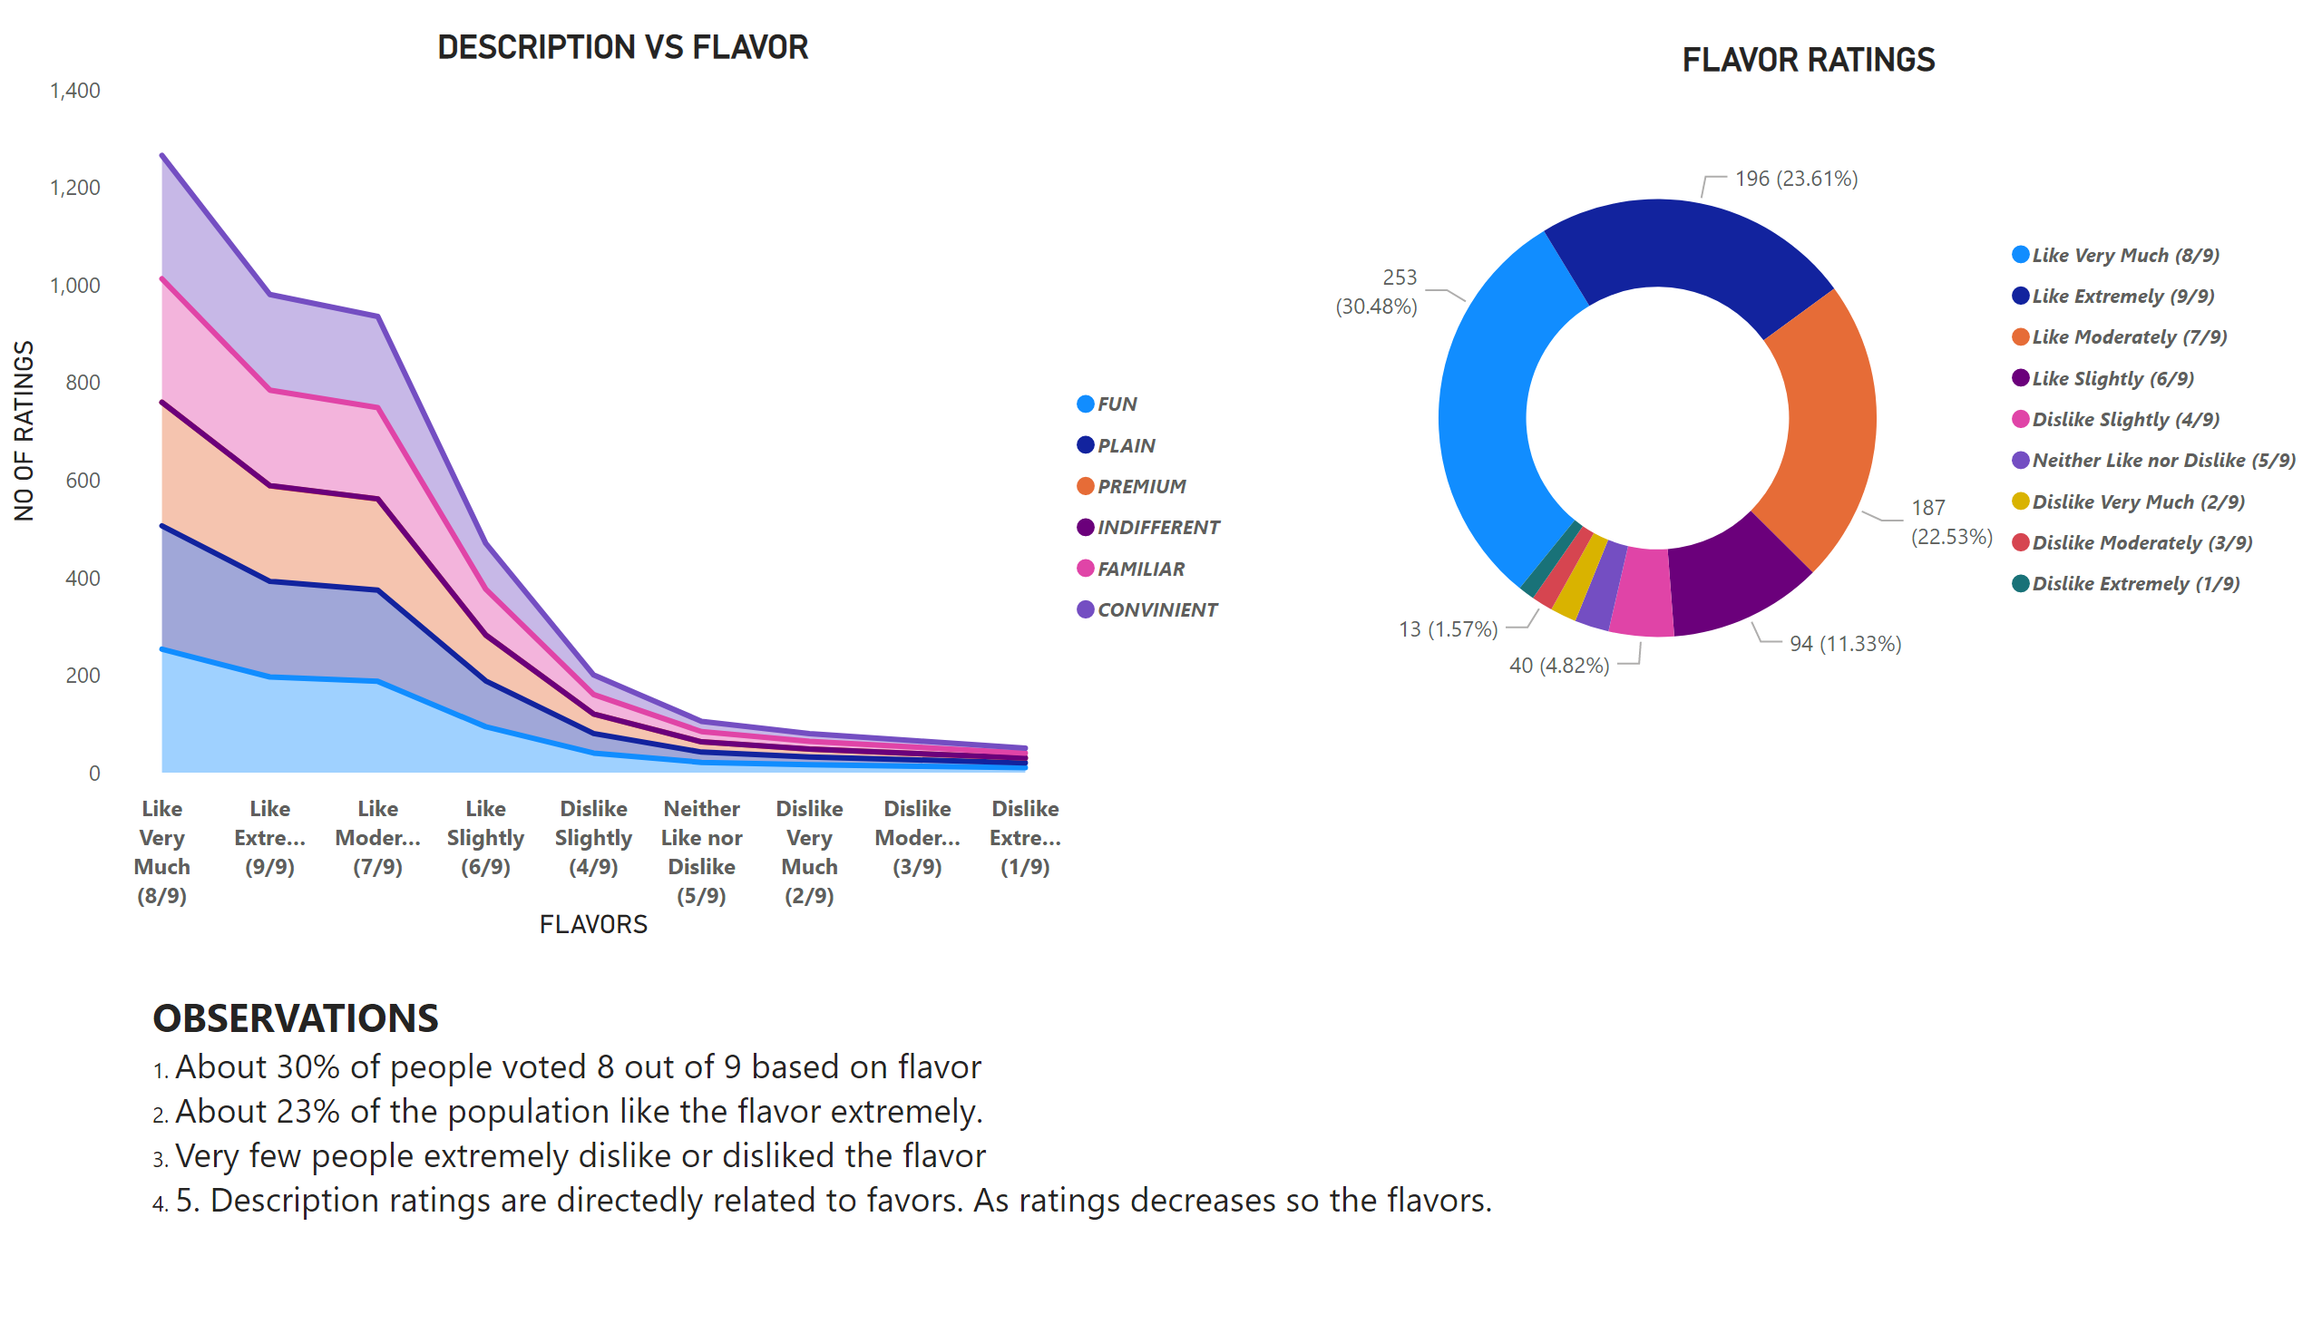
FLAVOR - DESCRIPTION
Notes:
DESCRIPTION VS FLAVOR
No alt text provided
FLAVOR RATINGS
No alt text provided
textbox
No alt text provided

Slide 5
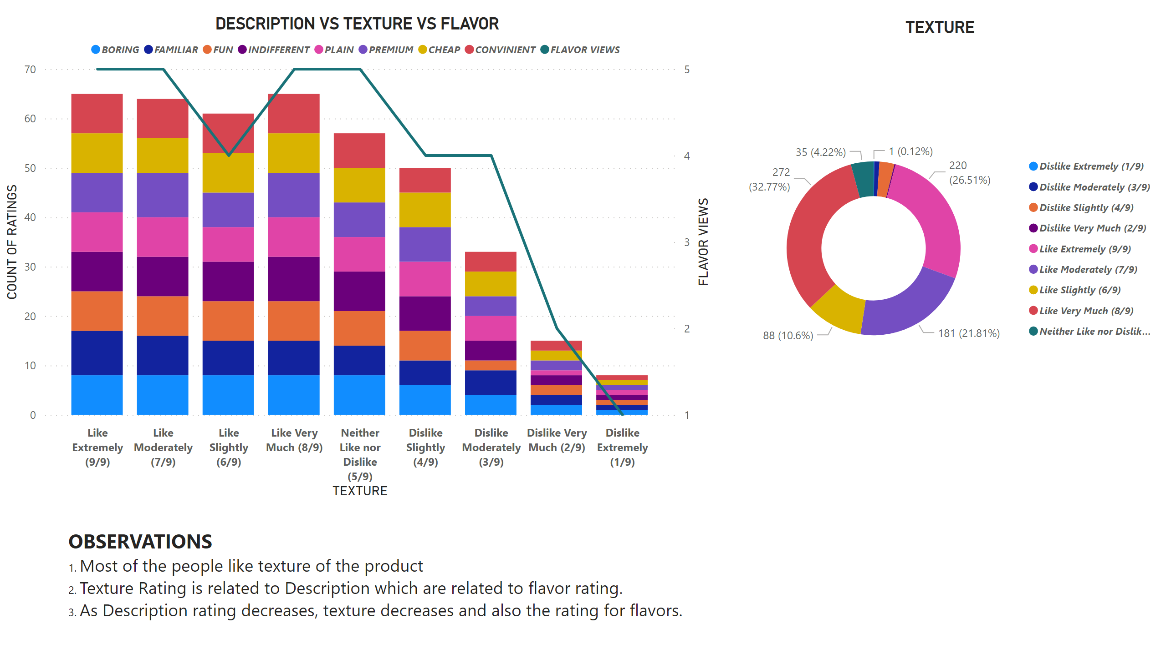
FLAVOR DESCRIPTION TEXTURE
Notes:
DESCRIPTION VS TEXTURE VS FLAVOR
No alt text provided
TEXTURE
No alt text provided
textbox
No alt text provided

Slide 6
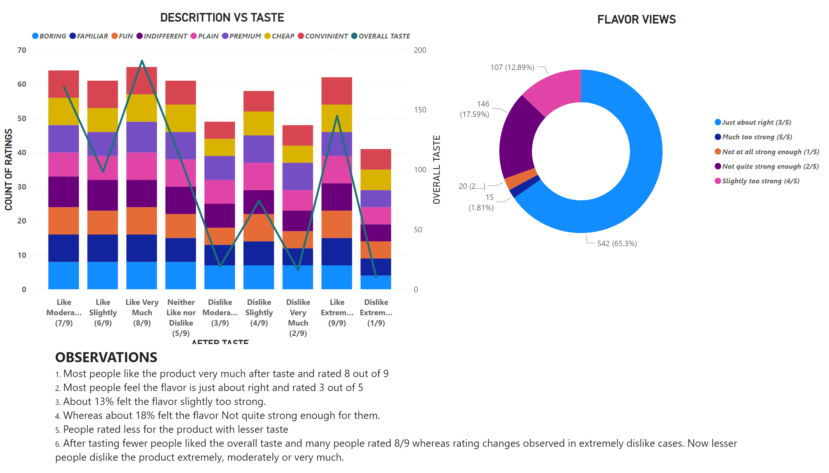
DESCRIPTION VS TEXTURE VS FLAVOR
Notes:
DESCRITTION VS TASTE
No alt text provided
FLAVOR VIEWS
No alt text provided
textbox
No alt text provided

Slide 7
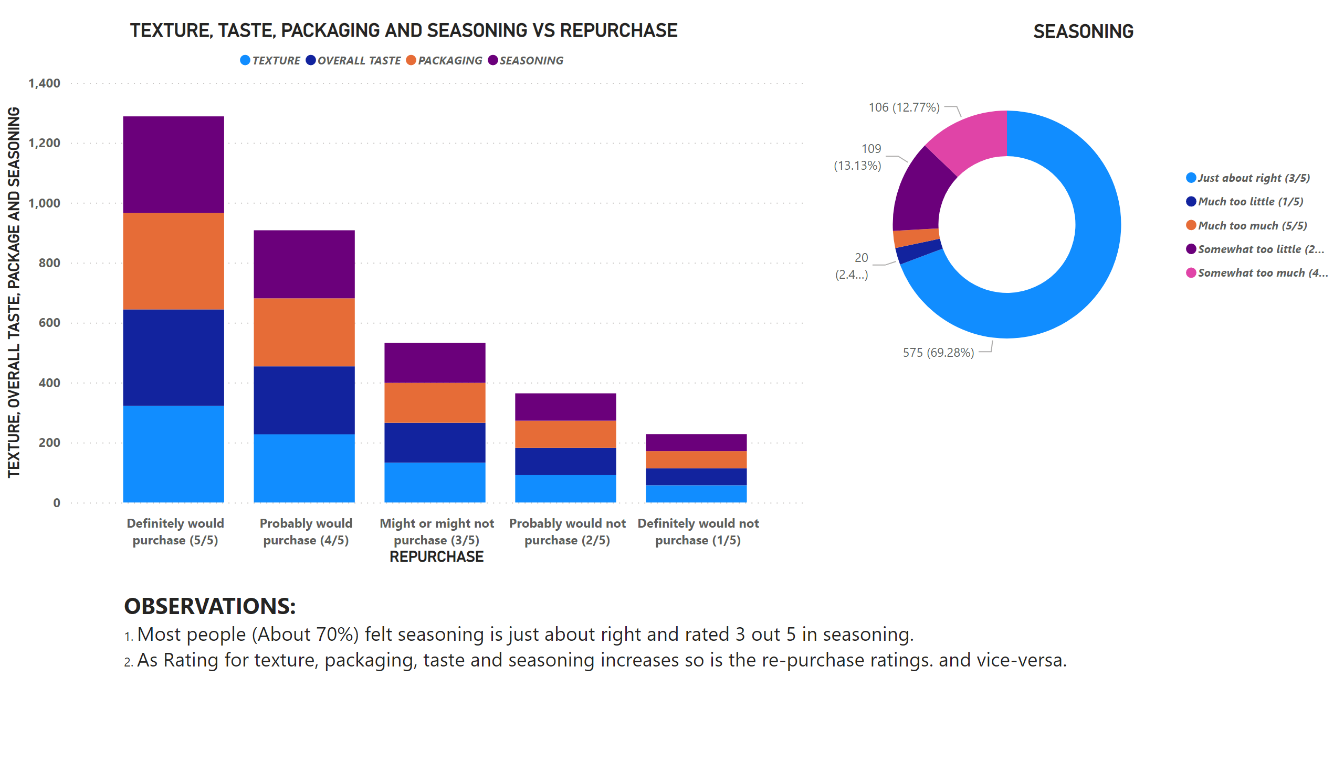
TEXTURE, TASTE, PACKAGE SEASONING VS REPURCHASE
Notes:
TEXTURE, TASTE, PACKAGING AND SEASONING VS REPURCHASE
No alt text provided
SEASONING
No alt text provided
textbox
No alt text provided

Slide 8
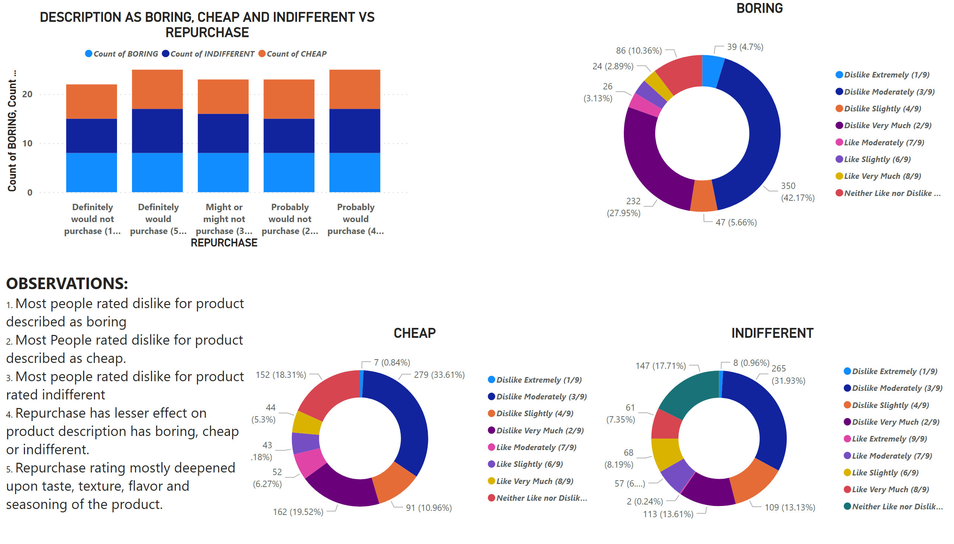
DESC AS CHEAP, BORING AND INDIFFERENT VS REPURCHASE
Notes:
DESCRIPTION AS BORING, CHEAP AND INDIFFERENT VS REPURCHASE
No alt text provided
BORING
No alt text provided
CHEAP
No alt text provided
INDIFFERENT
No alt text provided
textbox
No alt text provided

Slide 9
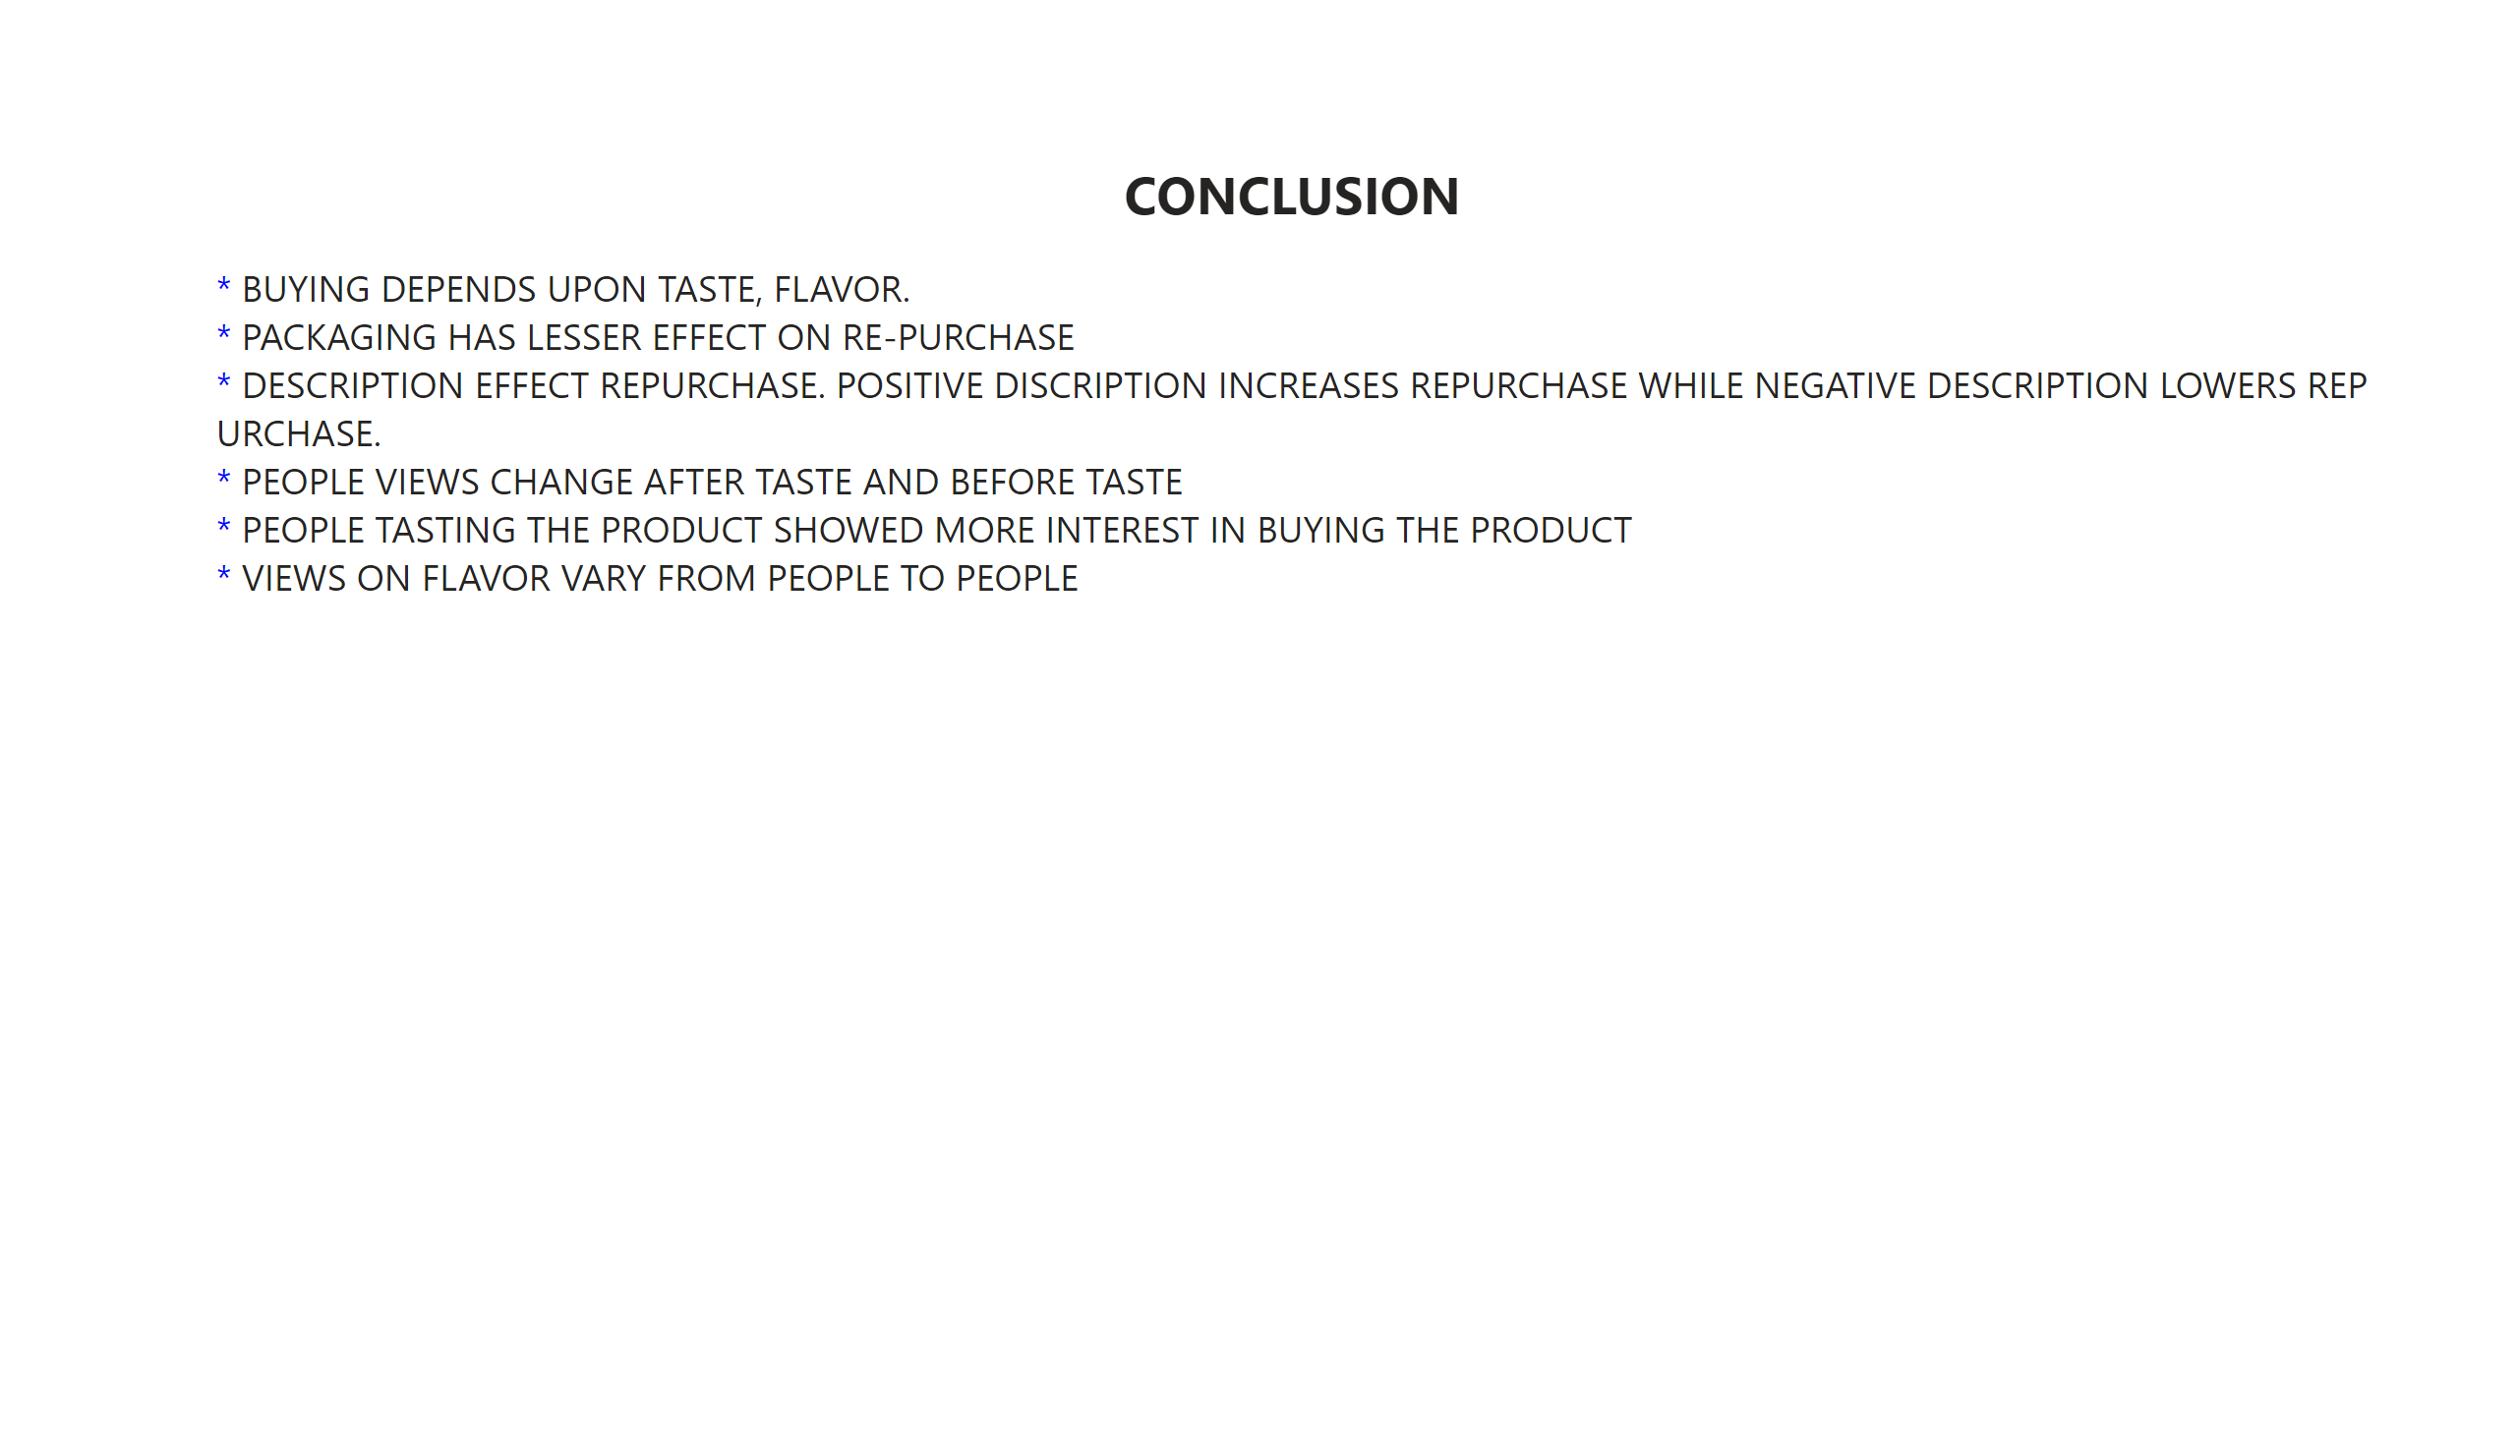
CONCLUSION
Notes:
textbox
No alt text provided

